Slide 1
Mutation-Enhanced International Prognostic Scoring System (MIPSS) for Primary Myelofibrosis:
An AGIMM & IWG-MRT Project
Abstract #405
Vannucchi AM

Slide 2
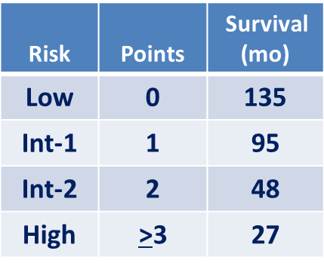
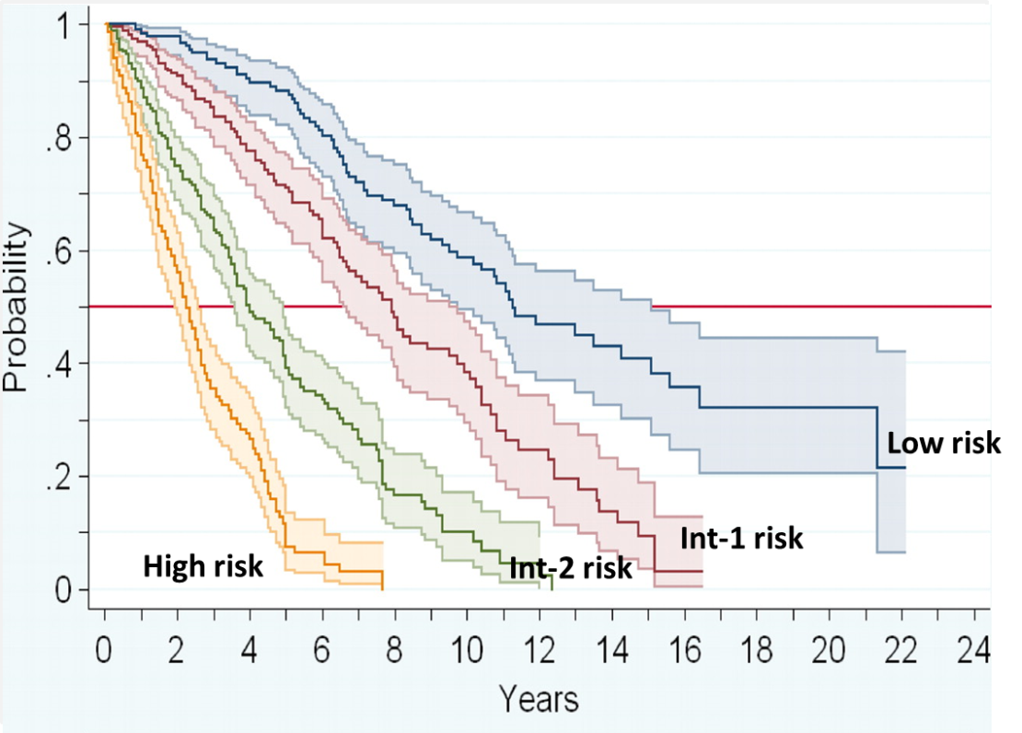
Background - I
In primary myelofibrosis (PMF), survival from time of diagnosis is predicted by the International Prognostic Scoring System (IPSS).
Variables included are age, leukocytosis, blasts, anemia, constitutional symptoms.
The dynamic IPSS (DIPSS) or DIPSS-plus provide survival estimates from time of patient referral.
Cervantes F, et al. Blood. 2009;113:2895-2901. Passamonti F, et al. Blood. 2010;115:1703-1708. Tefferi A, et al. Mayo Clin Proc. 2012;87:25-33.
Vannucchi AM, et al. Blood. 2014;124: Abstract 405.

Slide 3
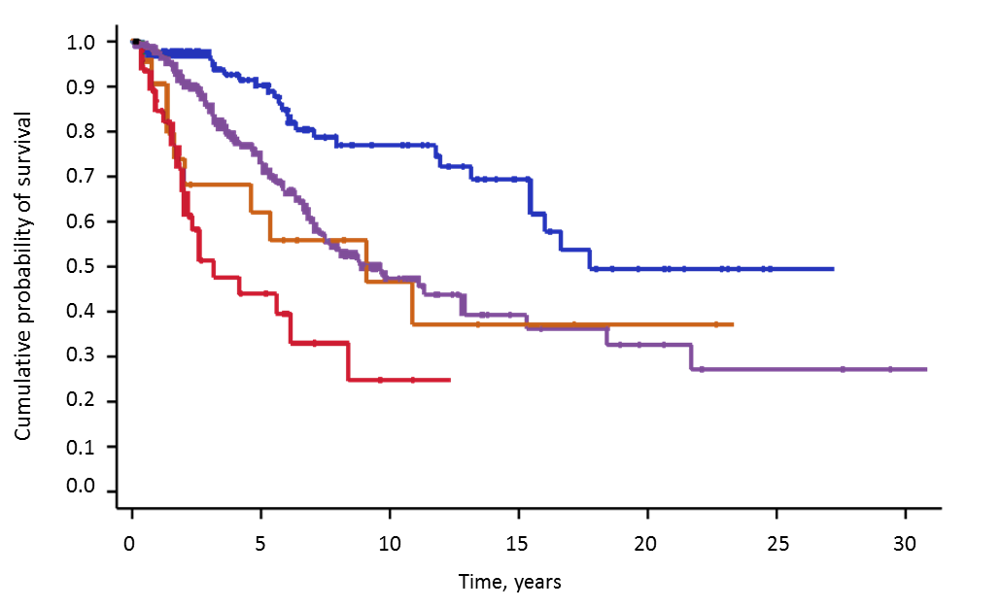
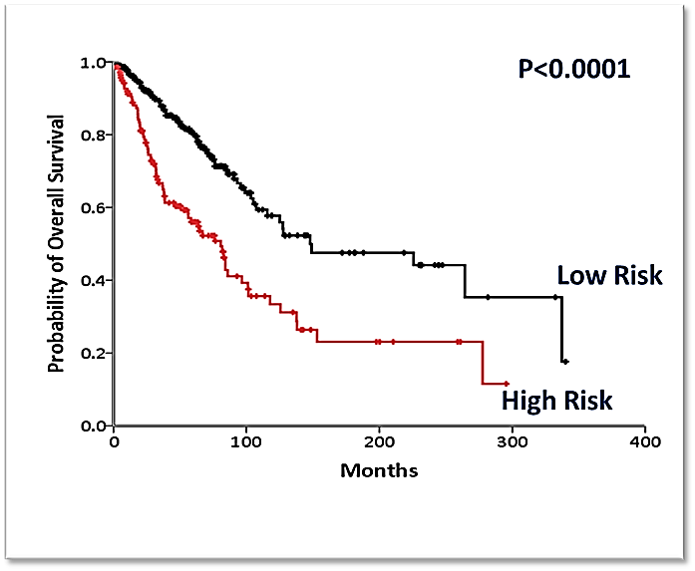
Background - II
The mutational status of JAK2, MPL and CALR and the presence and number of other prognostically-relevant mutations (ASXL1, SRSF2, EZH2, IDH1/2) provide IPSS/DIPSS-plus independent prognostic information.
CALR mutant
JAK2 mutant
MPL mutant
Triple negative
HR = 2.29 (P< .0001)
HR: 2.3 for JAK2V617F (P<.001)
2.6 for MPL (P = .009)
6.2 for TN (P<.001)
High risk: Any mutation in ASXL1, EZH2, SRSF2, IDH1/2
Rumi E, et al. Blood. 2014;124:1062-1069. Vannucchi AM, et al. Leukemia. 2013;27:1861-1869.
Vannucchi AM, et al. Blood. 2014;124: Abstract 405.
Notes:
CALR mutant (median OS 17.7 yr)
JAK2 mutant (median OS 9.2 yr)
MPL mutant (median OS 9.1 yr)
Triple negative (median OS 3.2 yr

Slide 4
Aim and Design
The objective of the current study was to devise a new score by including clinical and mutation-relevant prognostic information.
The prognostic model (MIPSS) was developed through a stepwise selection process, based on a z-test of the regression coefficients, and its relative quality was measured by means of the Akaike information criterion.
We used a "learning cohort" (European; n = 588 PMF patients at diagnosis) and a "validation cohort" (Mayo Clinic, Rochester; n = 398 PMF patients at the time of referral)
Mutations were analyzed by deep target resequencing (Ion PGM platform), RTQ-PCR, bidiretional Sanger sequencing, as appropriate
Vannucchi AM, et al. Blood. 2014;124: Abstract 405.

Slide 5
Patients’ Characteristics
Variables | European cohort (n = 588)
Age in years; median (range) | 61.9 (14-90)
Males (%) | 361 (61.4%)
Hemoglobin, g/L; median (range) | 117 (40-155)
Leukocytes, x 10⁹/L; median (range) | 8.9 (1.4-109)
Platelets, x 10⁹/L; median (range) | 309 (19-3279)
Circulating blasts ≥1%; n (%) | 102 (17.3%)
Constitutional symptoms; n (%) | 168 (28.6%)
Palpable splenomegaly; n (%) >10 cm from LMC; n (%) | 440 (74.8%)
 | 104 (17.7%)
Unfavorable karyotype 8(n = 252)* | 24 (9.5%)
IPSS Risk categories N (%) Low Intermediate-1 Intermediate-2 High | 126 (25.5%) 147 (29.8%) 116 (23.5%) 104 (21.1%)
Progression to leukemia; n (%) | 67 (11.4%)
Death; n (%) | 196 (33.3%)
*Unfavorable karyotype: +8,-7/7q-,i(17q),inv(3), -5/5q-,12p-, 11q23 rearr
Vannucchi AM, et al. Blood. 2014;124: Abstract 405.

Slide 6
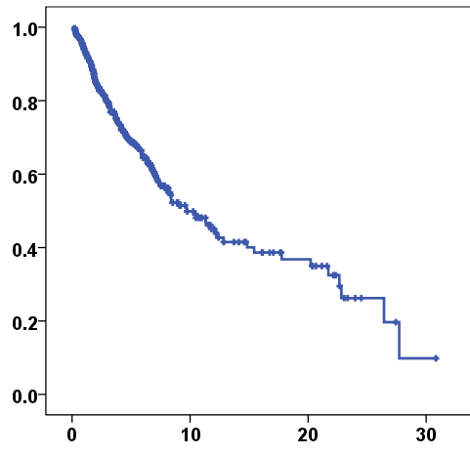
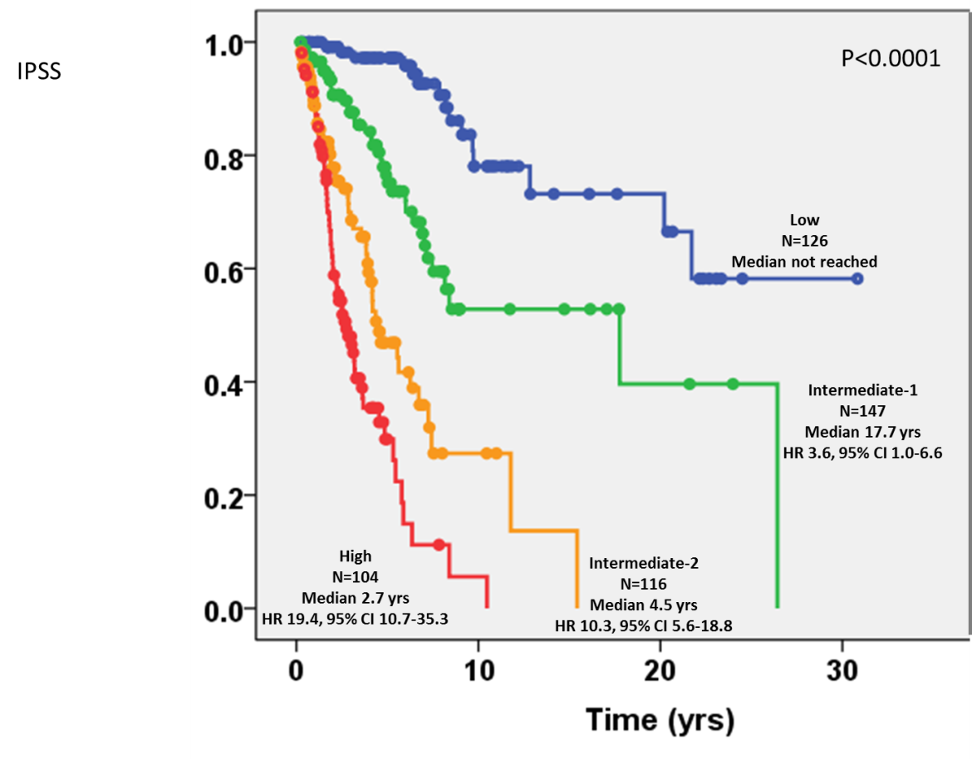
Learning Cohort: Survival by IPSS Score
Overall Survival
IPSS Stratification
P <.0001
Proportion
Proportion
Median OS: 9.72 y
(7.5-11.9 y)
Time, years
Time, years
Vannucchi AM, et al. Blood. 2014;124: Abstract 405.

Slide 7

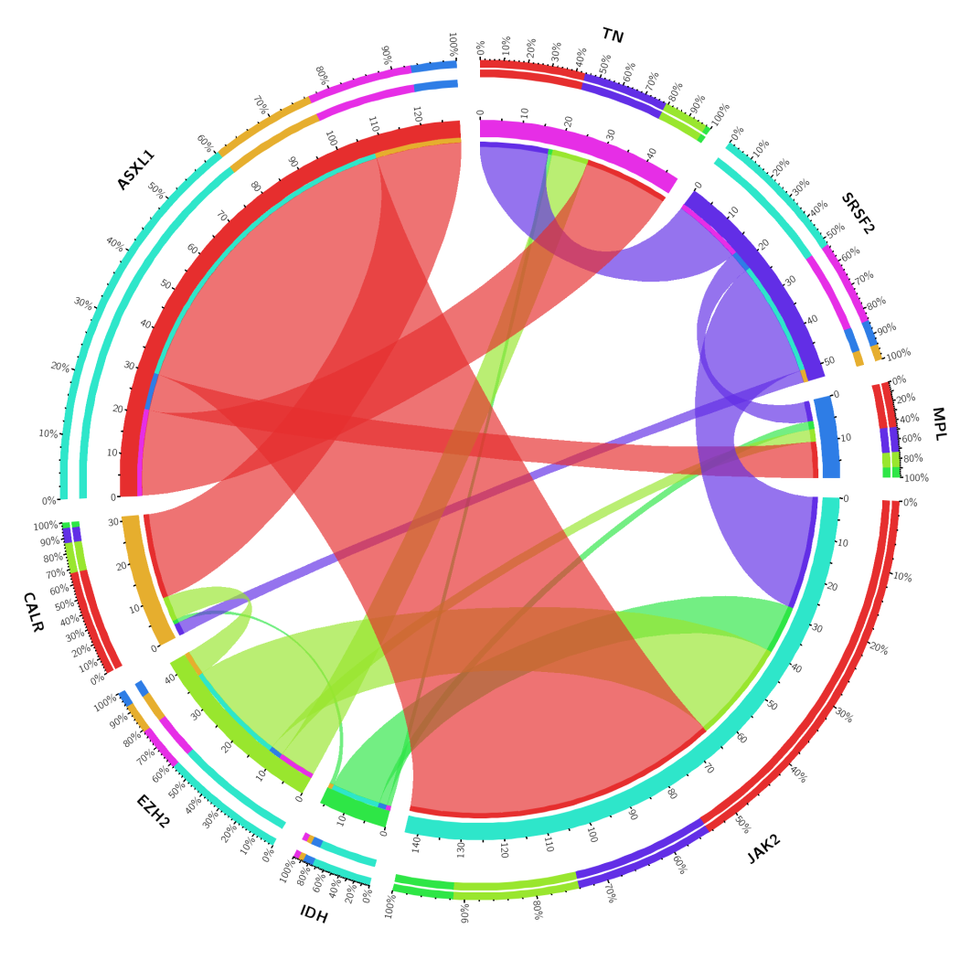
Mutation Profile in the Learning Cohort
Mutation | % Mutated
JAK2 V617F | 63.1
CALR | 19.7
MPL W515 | 6.0
ASXL1 | 21.8
SRSF2 | 9.01
EZH2 | 7.14
IDH1/2 | 2.55
Vannucchi AM, et al. Blood. 2014;124: Abstract 405.

Slide 8
Variables Associated With Reduced OS (Univariate Analysis)
Variables | HR (95% CI) | P
Age >60yrs | 5.19 (3.71-7.23) | <0.0001
WBC >25x10⁹/L | 4.4 (2.89-6.71) | <0.0001
Hb <100g/L | 3.20 (2.37-4.33) | <0.0001
PB Blasts ≥1% | 2.4 (1.7-3.4) | <0.0001
Constitutional Symptoms | 2.33 (1.7-3.1) | <0.0001
PLT <200x10⁹/L | 3.79 (2.79-5.15) | <0.0001
Unfavorable Karyotype | 2.9 (1.7-5.0) | <0.0001
Splenomegaly >10 cm from LCM | 2.0 (1.4-2.8) | <0.0001
Grade 2-3 BM fibrosis | 9.6 (3.0-30.3) | <0.0001
Triple negativity | 3.39 (2.40-4.79) | <0.0001
CALR mutation | 0.34 (0.22-0.52) | <0.0001
ASXL1 mutation | 1.95 (1.45-2.63) | <0.0001
SRSF2 mutation | 3.15 (2.14-4.63) | <0.0001
EZH2 mutation | 1.8 (1.13-3.0) | 0.014
IDH1/2 mutation | 2.9 (1.3-6.2) | 0.006
IPSS
DIPSS-plus
HMR
Vannucchi AM, et al. Blood. 2014;124: Abstract 405.

Slide 9
MIPSS: Molecular International Prognostic Score System
MULTIVARIATE ANALYSIS
Variables | HR (95% CI) | P
Age >60yrs | 3.8 (2.60-5.51) | <0.0001
Hb <100g/L | 1.4 (1.01-1.99) | 0.04
Constitutional symptoms | 1.5 .(1.13-2.16) | 0.007
PLT <200x10⁹/L | 2.5 (1.77-3.42) | <0.0001
Triple Negativity | 3.9 (2.20-6.80) | <0.0001
JAK2/MPL mutation | 1.8 (1.11-2.90) | 0.016
ASXL1 mutation | 1.4 (1.06-1.99) | 0.02
SRSF2 mutation | 1.7 (1.08-2.58) | 0.02
Vannucchi AM, et al. Blood. 2014;124: Abstract 405.

Slide 10
MIPSS: Molecular International Prognostic Score System
MULTIVARIATE ANALYSIS
Variables | HR (95% CI) | P
Age >60yrs | 3.8 (2.60-5.51) | <0.0001
Hb <100g/L | 1.4 (1.01-1.99) | 0.04
Constitutional symptoms | 1.5 .(1.13-2.16) | 0.007
PLT <200x10⁹/L | 2.5 (1.77-3.42) | <0.0001
Triple Negativity | 3.9 (2.20-6.80) | <0.0001
JAK2/MPL mutation | 1.8 (1.11-2.90) | 0.016
ASXL1 mutation | 1.4 (1.06-1.99) | 0.02
SRSF2 mutation | 1.7 (1.08-2.58) | 0.02
Weighted value
1.5
0.5
0.5
1.0
1.5
0.5
0.5
0.5
Vannucchi AM, et al. Blood. 2014;124: Abstract 405.

Slide 11
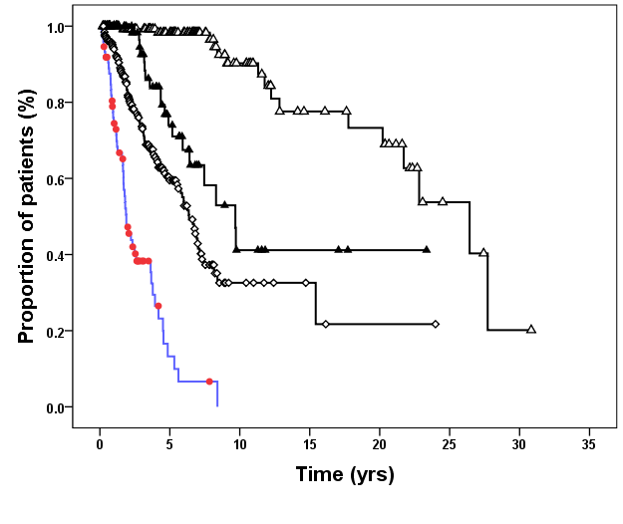
Development of the MIPSS Score in the Learning Cohort
Risk category | Score | % of pts | OS (y) | HR
Low | 0-0.5 | 27 | 26.4 | 1
Int-1 | 1-1.5 | 14 | 9.7 | 4.7
Int-2 | 2-3.5 | 46 | 6.4 | 9.9
High | >4 | 13 | 1.9 | 36.5
Int-1
Int-2
Low
P < .001
High
Vannucchi AM, et al. Blood. 2014;124: Abstract 405.

Slide 12
Development of the MIPSS Score in the Learning Cohort
Risk category | Score | % of pts | OS (y) | HR
Low | 0-0.5 | 27 | 26.4 | 1
Int-1 | 1-1.5 | 14 | 9.7 | 4.7
Int-2 | 2-3.5 | 46 | 6.4 | 9.9
High | >4 | 13 | 1.9 | 36.5
Int-1
Akaike information criterion indicated that MIPSS performed better than IPSS in predicting survival (1611.6 vs 1649.0).
Int-2
Low
P < .001
High
Vannucchi AM, et al. Blood. 2014;124: Abstract 405.

Slide 13
Performance of the MIPSS Score in the “Mayo” Validation Cohort
Risk category | Score | % of pts | OS (y) | HR
Low | 0-0.5 | 13 | 17.6 | 1
Int-1 | 1-1.5 | 17 | 7.8 | 2.6
Int-2 | 2-3.5 | 53 | 4.3 | 6.3
High | >4 | 17 | 1.6 | 15.9
1
.8
.6
Low
N = 398 DIPSS-plus patients
.4
Int-1
.2
High
Int-2
P < .001
0
0
2.5
5
7.5
10
12.5
15
17.5
20
22.5
Vannucchi AM, et al. Blood. 2014;124: Abstract 405.

Slide 14
Comparison of IPSS and MIPSS
IPSS - LOW
IPSS - INT-1
IPSS - INT-2
IPSS - HIGH
6%
2%
4%
4%
9%
8%
16%
17%
24%
65%
50%
77%
46%
72%
Concordance
rate
77%
24%
72%
50%
LOW
INT-1
INT-2
HIGH
MIPSS
Vannucchi AM, et al. Blood. 2014;124: Abstract 405.

Slide 15
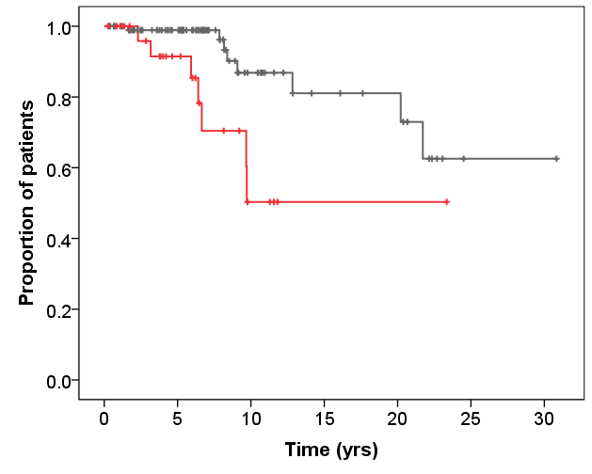
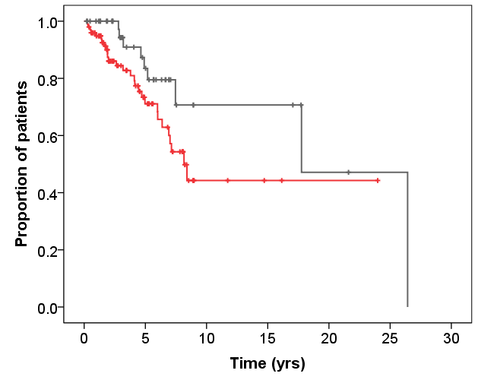
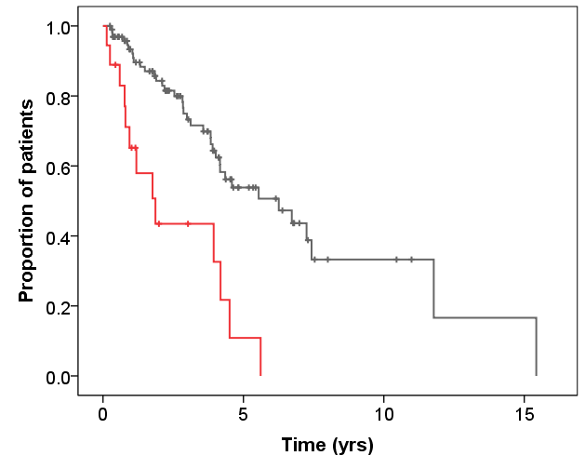
MIPSS Permits to Refine Prognostic Stratification Within the IPSS Categories
IPSS - LOW
IPSS - INT-1
IPSS - INT-2
*
§
*
*
23.4y
17.7y
4.5y
P = .005
P = .040
P = <.001
§
Low 24.9y
< Int-1 17.7y
< Int-2 6.2y
>Low 15.3y
§
>Int-1 8.1y
>Int-2 1.9y
§
Estimated
*IPSS median survival
MIPSS
Vannucchi AM, et al. Blood. 2014;124: Abstract 405.
Notes:
In a retrospective study by Dr. Kroger and coworkers at thie meeting, the survival of patients within different DIPSS categories treated with conventional therapy or SCT were compared. The figures of survival at 1, 5, 10 yrs after diagnosis for patients with intermediate-1 disease were 78%, 52%, and 41%, respectively, after SCT, and 97%, 77%, and 63% for non-transplanted patients.

Slide 16
Conclusions
MIPSS, a novel clinico-molecular score for patients with PMF, incorporates 4 clinical variables (age, HB, platelet count, constitutional symptoms) and 4 molecular variables (Triple negativity, JAK2/MPL mutation, ASXL1 and SRSF2 mutations)
MIPSS proved better performing than IPSS for predicting survival in PMF patients by Akaike information criterion
MIPSS allows to identify subgroups of patients with less favorable prognosis within the conventional IPSS categories
Vannucchi AM, et al. Blood. 2014;124: Abstract 405.

Slide 17
MIPSS: When and for Whom?
A) in the setting of HSCT:
For potential candidates falling in the Int-1 and Int-2 IPSS risk category
B) in the setting of clinical trials:
For “personalized” medicine approach
Vannucchi AM, et al. Blood. 2014;124: Abstract 405.

